Slide 1
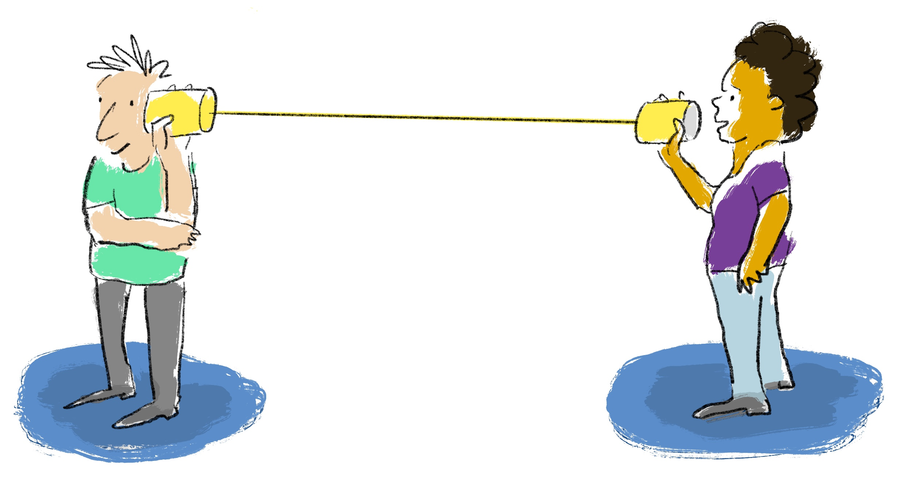
PES 318
By:
Mr. Mukesh Mahay

Slide 2
Attitude Reconstruction
The way we perceive or think about something or situation.
Why is this important ?
It makes our personality
It gives us scope
It allows us to act , grow, achieve

Slide 3
What is workplace and Workstation?
Workplace is the broader work facility, to work for the organization
Respected guidelines, behavior is expected to be followed like punch access, movement etc.
Workstation is the specific area located to work in the office
As it is a specific are to work, person has to adhere the boarder as well as workstation etiquette like email, calls , meetings

Slide 4
Poll
If during a project your team member is not able to finish the task, which skill will you use ?
Empathy
Decision Making

Slide 5
Email Etiquette
Email Id
To , CC, BCC
Subject line
Content/Salutations/Language
Content
Ending
Attachments
Signature(What all can be added)

Slide 6
Email Pointers
Briefly introduce yourself. Do not assume the person receiving your e-mail knows who you are
Don't "e-mail angry." E-mailing with bad news, firing a client
Use exclamation points sparingly. The maximum number of exclamation points in a business e-mail
Be careful with confidential information. Refrain from discussing confidential information in e-mails
Respond in a timely fashion. Unless you work in some type of emergency capacity, it's not necessary to be available the instant an e-mail arrives. Depending on the nature of the e-mail and the sender, responding within 24 to 48 hours is acceptable
Refrain from sending one-liners. "Thanks," and "Oh, OK"
Avoid using shortcuts to real words, emoticons, jargon, or slang
Be clear in your subject line. With inboxes being clogged by hundreds of e-mails a day
Don't get mistaken for Spam. Avoid subject lines that are in all caps, all lower case, and those that include URLs and exclamation
Provide a warning when sending large attachments
Beware of the "reply all." Do not hit "reply all"
Pick up the phone. When a topic has lots of parameters that need to be explained
Know your audience. Your e-mail greeting and sign-off/Always include a signature

Slide 7
Poll
In the email we can always request for the reply to the receiver?
Yes
No

Slide 8
Poll
We must always warn the receiver for the attachments sent
Yes
No

Slide 9
Let’s Practice email writing
Kindly write an email in the following situation as mentioned in the chat

Slide 10
Small Talk
Small talk is a short, friendly conversation about a common topic. Small talk can take place among friends, co-workers, or strangers. One reason why the ability to make small talk in business settings is so important is because small talk allows people to be friendly at work without getting too personal
Making Small Talk: When you have an opportunity to engage in small talk with other people, it's important to choose a good topic. Some of the most common small talk topics include:
Sports/athletes
Music/movies/books
Weather
Travel/tourism
Hobbies
Food/restaurants
Technology

Slide 11
Building Rapport
Rapport is a connection or relationship with someone else. It can be considered as a state of harmonious understanding with another individual or group. Building rapport is the process of developing that connection with someone else

Slide 12
Poll
While Pitching for self one must elaborate in detail the achievement
Yes
No

Slide 13
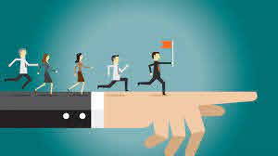
Team Work and Leadership
Teamwork can be simply defined, "as a state of unity achieved within a group of people working for a specific economic benefit.“
Discussions about teamwork in the workplace often revolve around a few central topics: effective communication, sharing a common goal, and solving problems. While each of these are absolutely essential in strong teams, one key often seems to be missing - Leadership.
Decisiveness
Integrity
Relationship building (or team building)
Dependability
Ability to teach and mentor

Slide 14

Notes:
Thank you and see you soon!

